Slide 1
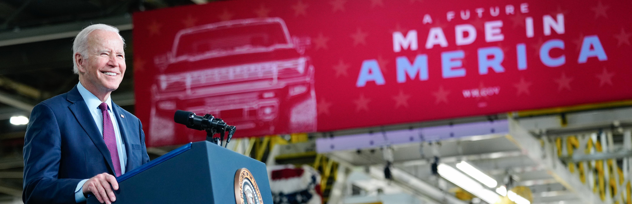
The Federal Sustainability Plan: Catalyzing Clean Energy Industries and Jobs Through Federal Sustainability
White House CSO
1

Slide 2
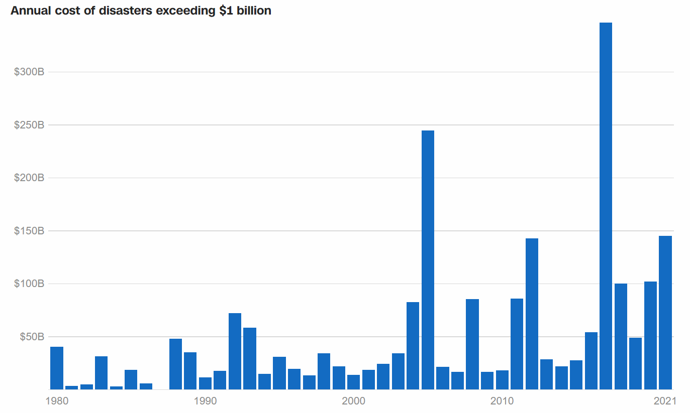
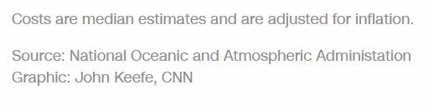
Climate change’s effects represent a clear and present danger, including the heightened frequency and intensity of natural disasters
Cost $750 billion in damages from 2016 to 2021
2021
$145 billion in damages
20 disasters >$1 billion
688 deaths
40% of U.S. counties affected
White House CSO
2

Slide 3
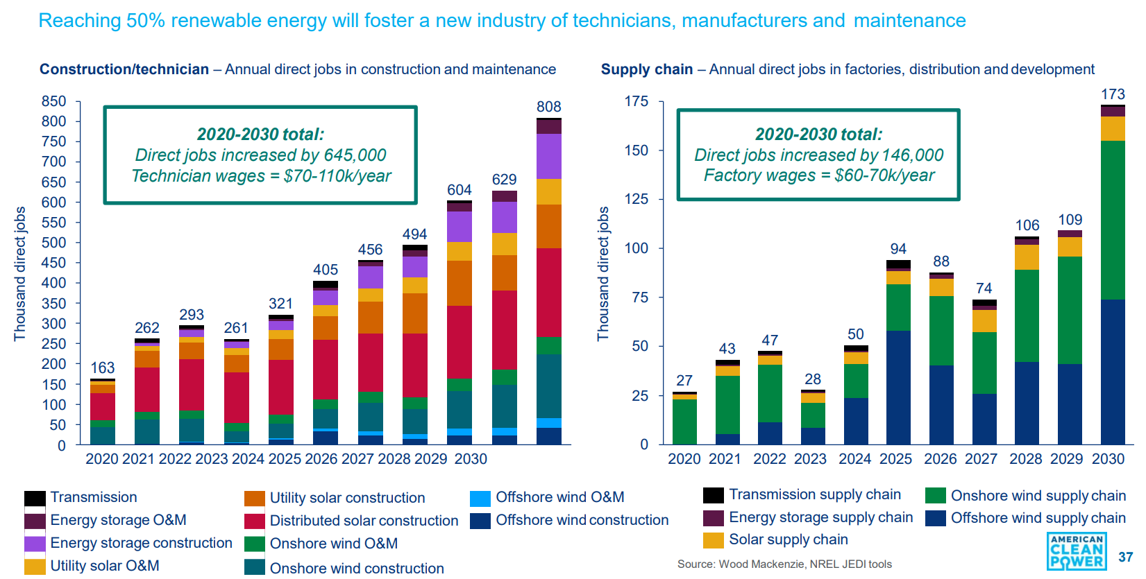
Our response to the climate crisis offers a once-in-a generation economic opportunity providing clean energy jobs and industries
White House CSO
3

Slide 4






The Federal Sustainability Plan places operations on track for net-zero emissions by 2050
Net-zero emissions operations by 2050
All fleet acquisitions ZEV by 2035
100% 24/7 carbon pollution-free electricity by 2035
Federal Sustainability Plan
Net-zero emissions procurement by 2050
Net-zero emissions buildings by
2045
Climate resilient infrastructure and operations
White House CSO
4

Slide 5






The plan focuses on making the 2020s a decade of action that starts now
65% operations emissions reduction by 2030
All light-duty purchases ZEV by 2027
100% CFE with 50% on a 24/7 basis by 2030
Federal Sustainability Plan
Supplier disclosure and Buy Clean
50% buildings emissions reduction by 2032
Climate adaptation and resilience plans
White House CSO
5

Slide 6



The plan’s enabling components expand and accelerate climate action
Mainstreaming sustainability within the Federal workforce
Advancing environmental justice and equity
Leveraging domestic and international partnerships
White House CSO
6

Slide 7



100% 24/7 CFE
The Federal Government is implementing a three-part strategy to achieve 100% CFE by 2030, with at least 50% on 24/7 basis
Engaging utilities
Using power
purchase agreements
Developing more onsite energy
White House CSO
7

Slide 8
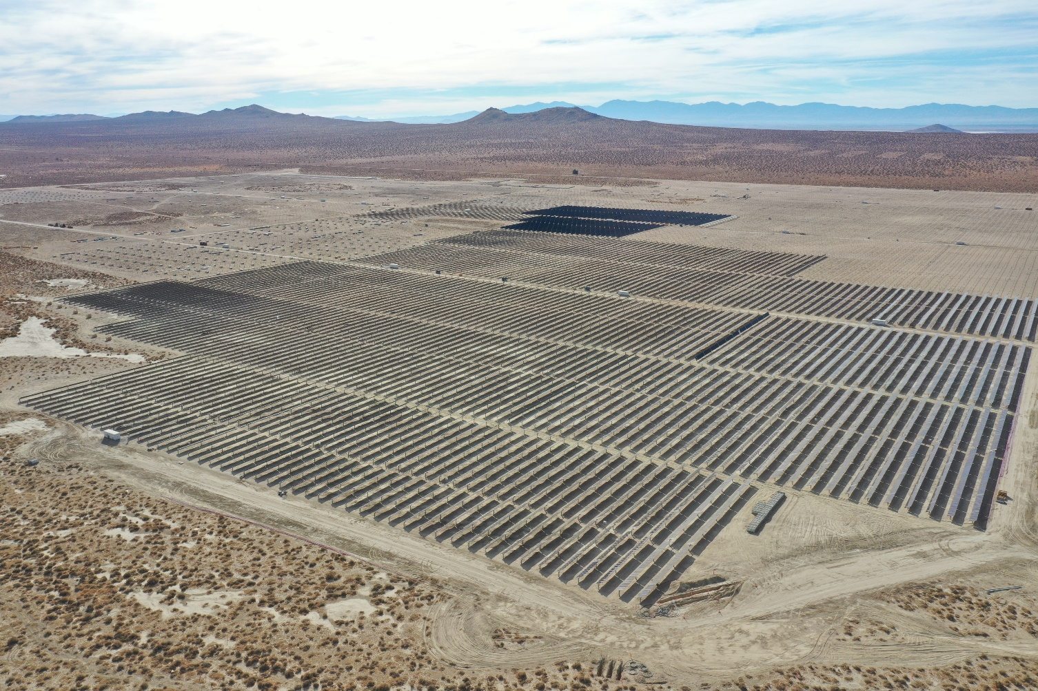




100% 24/7 CFE
The Federal Government is taking significant CFE action now by investing in clean energy industries
Edwards Air Force Base, California
Feb. 2022 DOD-GSA 24/7 CFE Request for Information
Purpose: Gather market information on capabilities in supplying hourly-matching CFE
to the Federal Government
A Microgrid on Every Army Installation by 2035
2022
520 MW (one of nation’s largest PV projects) of CFE added to the grid
1,000+ union and construction jobs created
Status: 950 renewable energy projects supplying 480 MW
of power
Goals: 25 microgrid energy projects planned through 2024
White House CSO
8

Slide 9
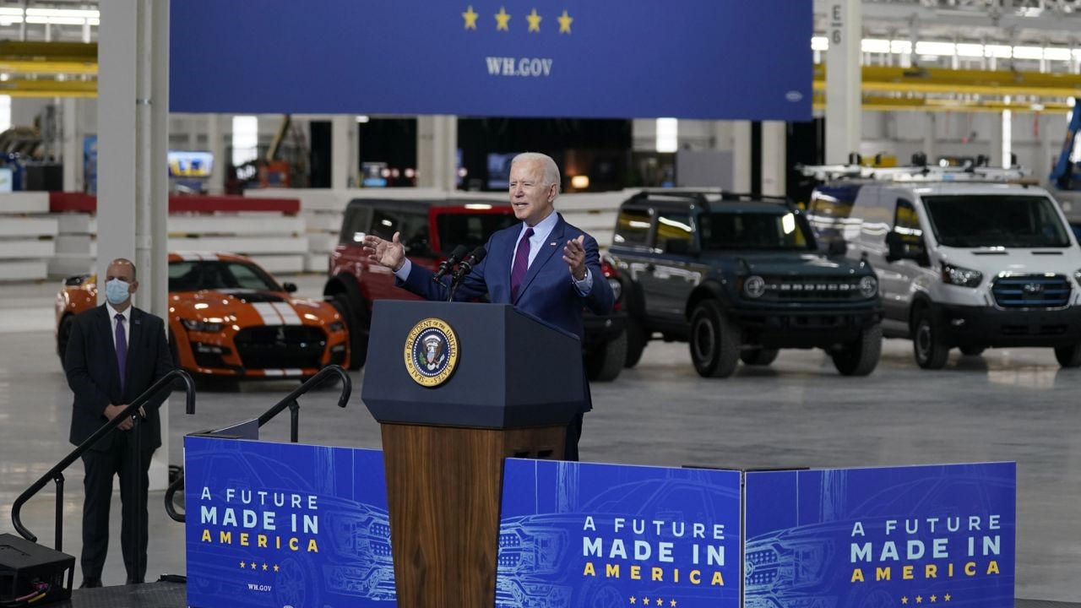


100% ZEV Federal Fleets
The plan implements agency targets to deliver electrification for all 600,000 cars and trucks making up the Federal fleet
2027
2035
100% of annual
light-duty vehicle acquisitions are ZEVs
100% of medium-
and heavy-duty
vehicle acquisitions are ZEVs
White House CSO
9

Slide 10
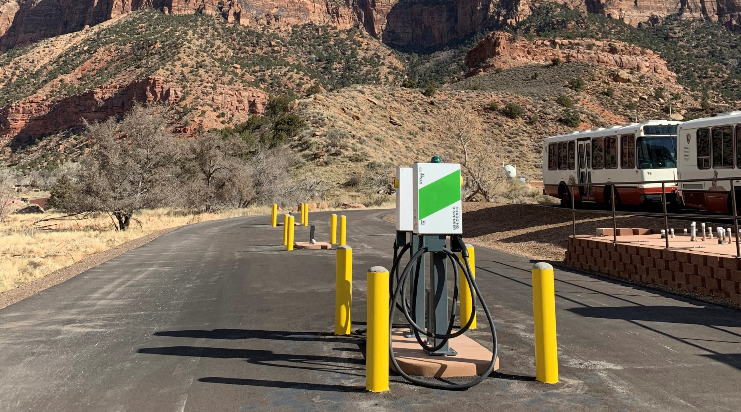


100% ZEV Federal Fleets
Federal agencies are investing in ZEVs to accelerate America’s industrial capacity
Zion National Park
Department of Homeland Security
Dept. of the Interior
30 battery electric buses and 27 charging stations will replace Zion’s 23-year-old fleet by 2025
DHS is field testing the Mach-E for its 30,000-vehicle fleet in 2022
DOI-U.S. Park Police lightweight motorcycles and dirt bikes will become 100% ZEV in DC, NYC, and San Francisco by 2025
White House CSO
10

Slide 11
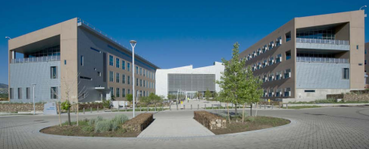
NZE Federal Buildings
Net-zero emissions buildings serve as a strategic foundation for emissions reduction
Achieve a net-zero emissions building portfolio by 2045
50% GHG emissions reduction by 2032
from 2008 levels
Prioritize energy efficiency
and elimination of
onsite fossil fuel use
DOE’s net-zero emissions National Renewable
Energy Laboratory, Colorado
White House CSO
11

Slide 12



NZE Federal Buildings
The plan provides a comprehensive framework, targeting multiple intervention points
Existing facilities
New construction
Leased spaces
Deep energy retrofits
Federal Building Performance Standard
Performance contracting
Increasing energy and water efficiency
Net-zero emissions
new construction
(all electric, super efficient)
Green leases
Leases in net-zero emission buildings
Cross-Cutting: Sustainable Federal Buildings, Sustainable and Equitable Site Locations
White House CSO
12

Slide 13


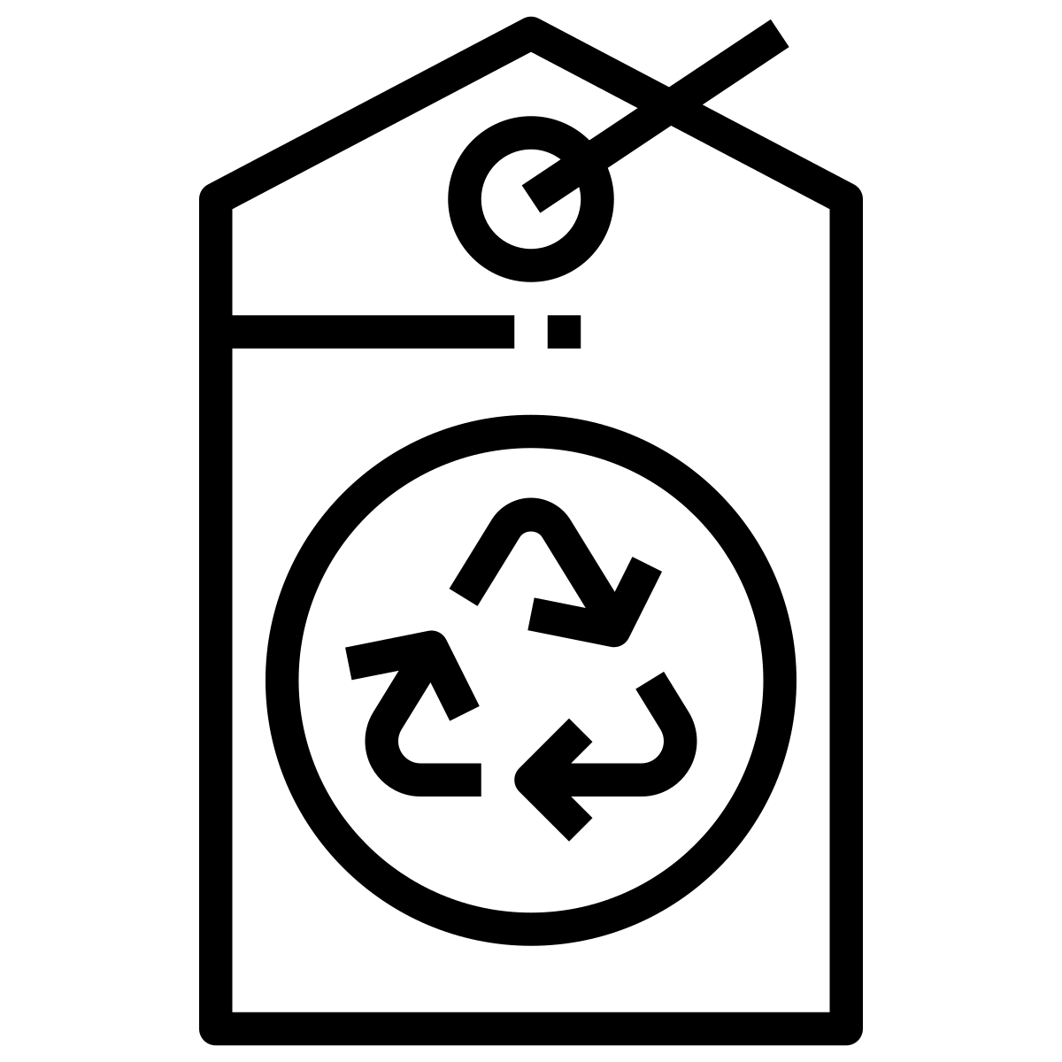
NZE Procurement
The plan leverages procurement to bolster America’s ability
to supply low-carbon and sustainable goods
Supplier
Emissions
Products and Services
Minimizing Risks of Climate
Federal suppliers will:
Disclose greenhouse gas emissions and climate risks
Set science-based emissions reduction targets
Catalyze markets for construction materials with lower-embodied emissions through a Buy Clean initiative
Require purchase of sustainable products and services, including avoiding the procurement of items with added PFAS
Integrate climate risk considerations into Federal procurement regulations
White House CSO
13

Slide 14
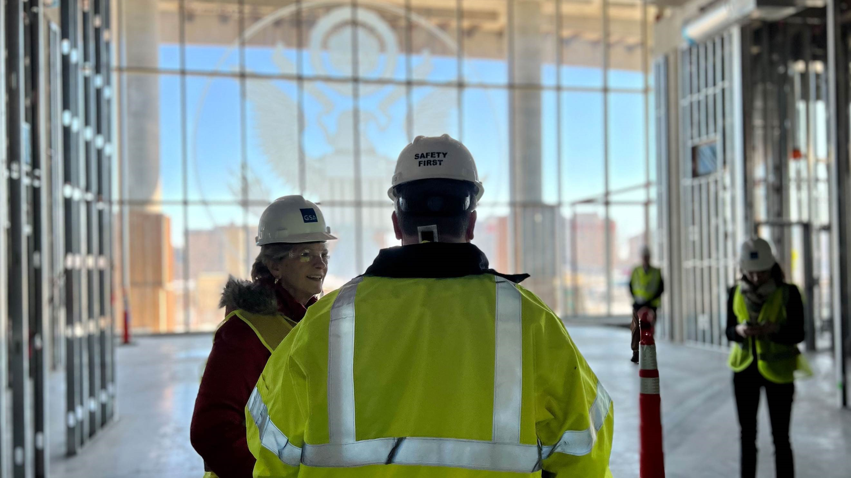
NZE Procurement
Federal Agencies are taking actions to achieve Federal Net Zero Emissions goal
Reducing Supplier Emissions
Sustainable Products and Services
Minimizing Risks of Climate
In March 2022, GSA issued its first “Buy Clean” standards for low-carbon concrete and environmentally preferable asphalt used at GSA job sites
In Feb. 2022, EPA issued a new resource to help Federal purchasers identify products without added PFAS
In support of Buy Clean, DOT and EPA are collaborating to develop a procurement framework for lower-carbon materials in highway projects
DOD is developing low-carbon purchasing guidelines based on 2021 supplier GHG reporting and measurement
GSA requires disclosure of embodied carbon of concrete and asphalt materials for new building and major modernization contracts 2022 onwards, including Bipartisan Infrastructure Law-funded projects
GSA Administrator Carnahan touring an all-electric Federal Courthouse in Des Moines, Iowa
White House CSO
14

Slide 15
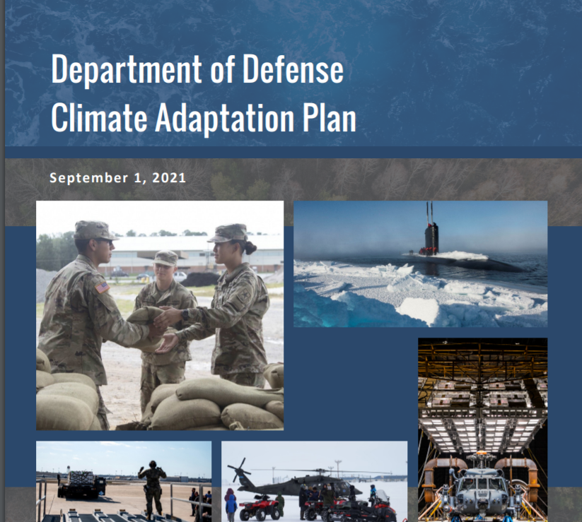
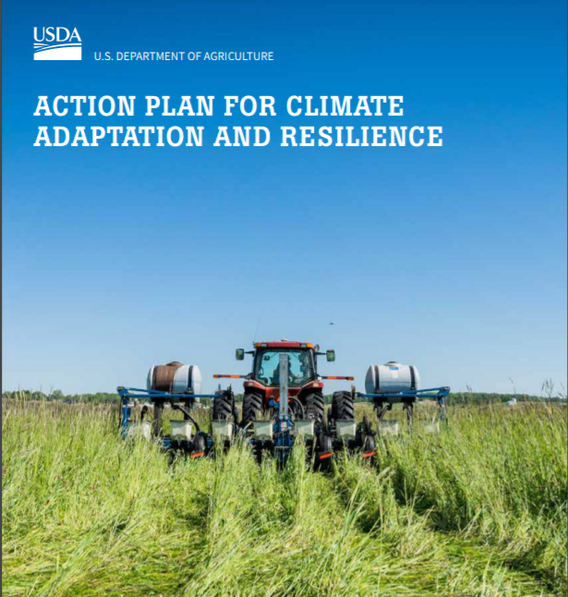
Climate Resilient Operations
The plan delivers a more resilient government against the adverse impacts of climate change
Federal Agency Climate Adaptation Plans
Implementing 2021 CAPs
In 2021, 20+ Federal agencies released plans to integrate climate-readiness across programs and bolster resilience of Federal assets
Major actions include:
Safeguarding Federal investments
Identifying leadership and accountability
Developing a more resilient supply chain
Enhancing protections for workers and communities
Building a more equitable future
Agencies will submit Annual Progress Reports beginning 2022
White House CSO
15

Slide 16

Climate Resilient Operations
Federal agencies are taking actions now to boost resilience and capacity
Developing More Resilient Supply Chains
Safeguarding Investments
DOD is using climate intelligence, including its Climate Assessment Tool, to inform military planners and other decision-makers on how military installations are at risk from climate change
NASA is screening its supplies of top mission-critical goods and services to identify those at risk of disruption by extreme weather events or long-term climate change
DOE is establishing clear climate adaptation requirements so that its contractors and suppliers employ climate adaptation and resilience practices
White House CSO
16

Slide 17
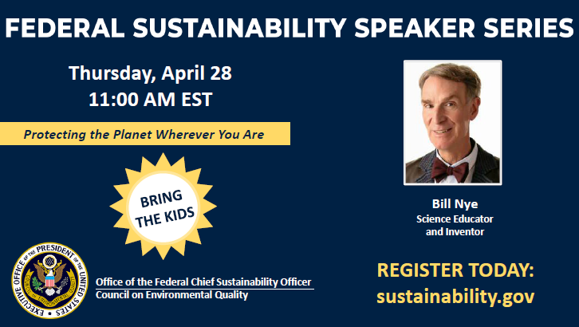
Mainstreaming Sustainability
The plan builds capacity and mainstreams sustainability in the Federal workforce
Foster a culture of
sustainability and climate action
Identify staff, training, and
resources needed
Incorporate sustainability and climate preparedness into our work
White House CSO
17

Slide 18
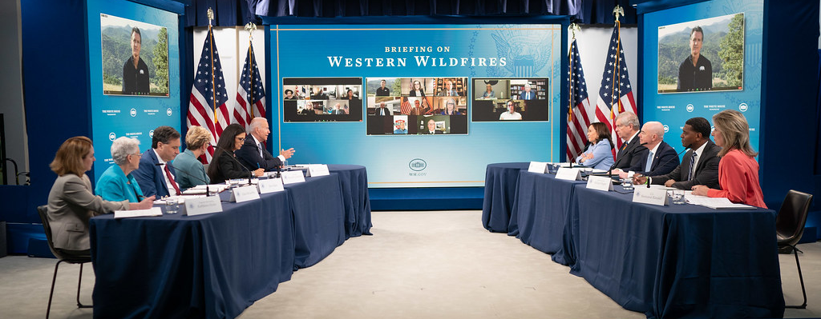
Mainstreaming Sustainability
The Federal Government is embedding sustainability and climate training throughout agencies
Building Internal Capacity and Boosting Employee Climate Literacy
In Jan. 22, DHS launched its Climate Change Professionals Program, which is recruiting recent graduates and current employees to
develop the next generation of climate experts
improve climate literacy throughout the Department, and
execute its Climate Action Plan
DOD is training all staff in climate literacy, allowing members to identify and address climate readiness actions
White House CSO
18

Slide 19


Advancing EJ and Equity
The plan ensures economic equity and environmental justice are key considerations in operations, planning, and decision-making
Include a Federal environmental justice representative
on the Chief Sustainability Officers Council
Incorporate
environmental justice efforts in agency sustainability and
climate adaptation plans
Reinforce equity in Federal contracting and operations
White House CSO
19

Slide 20



Leveraging Partnerships
The plan leverages domestic and international partnerships to go further and faster to achieve common goals
Launch a
Presidential Sustainability Executives Program
Partner with state, tribal, and local governments to accelerate progress
Co-lead an international Greening Government Initiative (GGI)
White House CSO
20

Slide 21
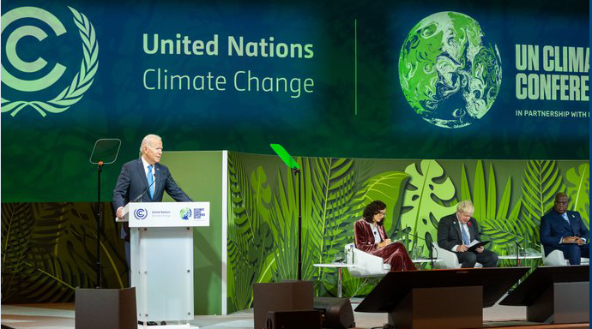
Leveraging Partnerships
Placeholder
President Biden launched the Greening Government Initiative as part of the 2021 Leaders Summit on Climate
GGI
40+ member nations committed
Collaborating across priority goals
100% 24/7 CFE
100% ZEV Fleets
NZE Buildings
NZE Procurement
Adaptation and Resilience
Engaging in global fora
COP
UN/Climate Week
White House CSO
21

Slide 22
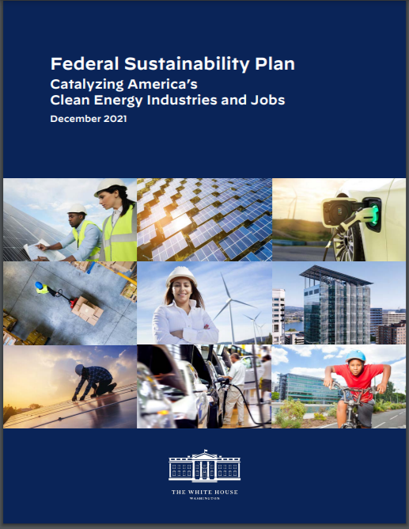


Stay Connected
www.sustainability.gov
@WhiteHouseCSO
White House CSO
22

